Slide 1
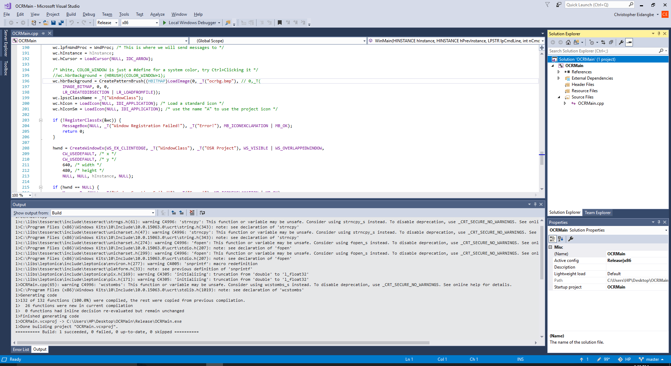
1) Build program in Visual Studio 2017

Slide 2
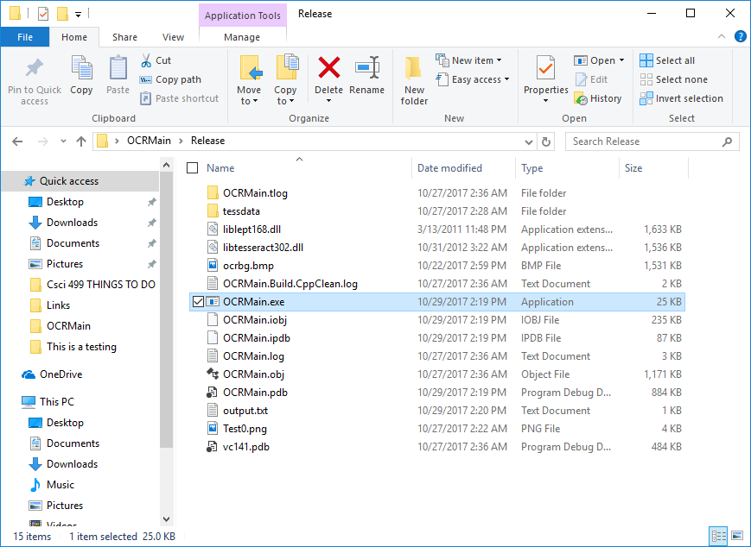
1) Go to folder where program is located > Release > double click OCRMain.exe

Slide 3
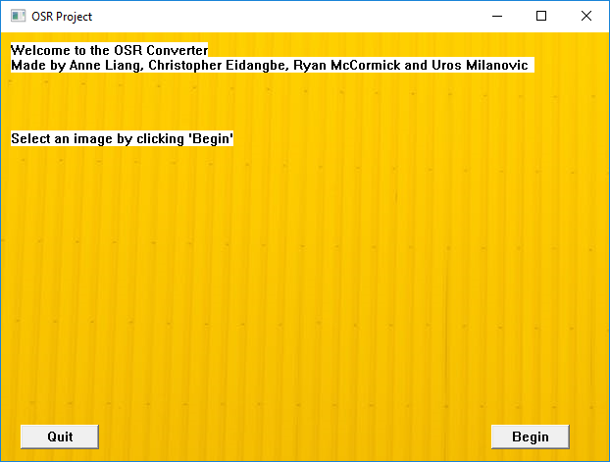
3) Click begin to select image (Test0.png) to convert

Slide 4
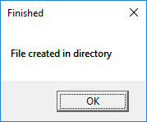
4) File is created in directory

Slide 5
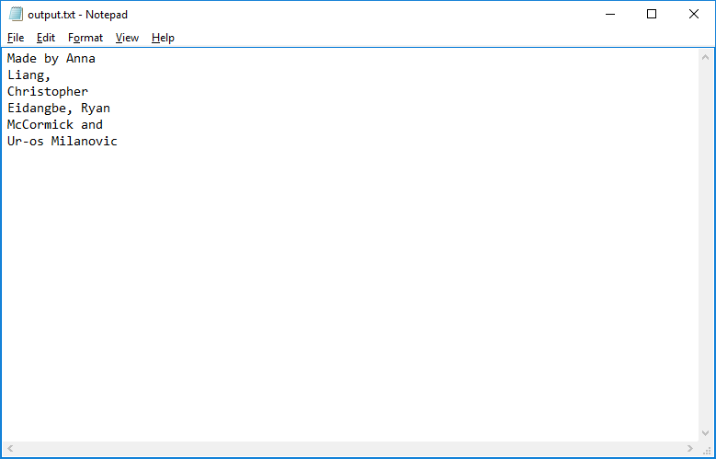
5) Text is outputted in the output.txt

